Slide 1
REAL ESTATE MANAGEMENT SYSTEM
ROHAN CHERIAN
22PMC145

Slide 2
ABSTRACT
Real estate is a type of business for selling, buying, renting land, buildings and offices. Real estate agencies duties include, to give the property on rent or else to sell the property. The system is built fully in Django Framework in back-end and HTML and CSS in front-end. This online Property management system can help you to get best property by just sitting at home or anywhere. Many people search for property for many purposes like residence, offices, faculty and etc. Every individual wants his house to be in the best location with best facilities. Offices should be near market area in order to increase sales and productivity. The system has three functional modules:Owner,Buyer,Admin.

Slide 3
REQUIREMENTS
View and book Available Properties
View property Booking details
View latest Properties
Manage registered users
Manage registered owners
Manage Requests
View Property

Slide 4
Features
Primary focus of this project is to reduce the difficulties related to property booking.
This online Property management system can help you to get best property by just sitting at home or anywhere.
Main reason for launching this website reduces the complexities related with the program arrangements and reduces the workload of the user.
Buyers can sign up.
Admin or owner can sign up.
User can view property uploaded details and images, or quote or book property.
Owner can view request details and accept or reject them.
This project will automate all the activities related to an property booking task.

Slide 5
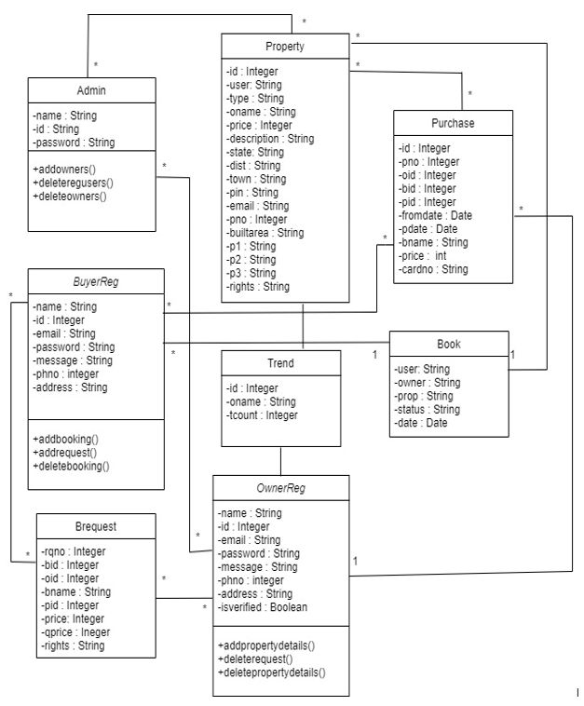
CLASS DIAGRAM

Slide 6
Challenges
The major challenge faced by me was to plan the process flow of the project. While coming to the coding part I had difficulties in using the Django user for registering customers as it was new to me. The next major challenge which I faced was during the integration of crispy-forms in my project. Even though it made my work easy by helping me from the hectic task of creating html pages , I did require some time to learn about the working of it.

Slide 7
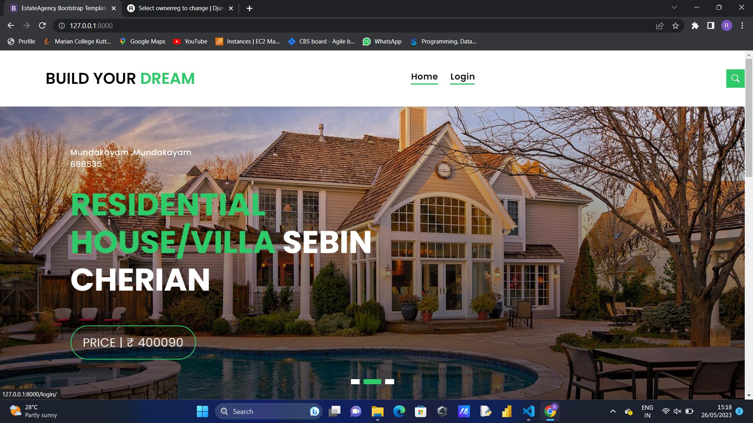
SCREENSHOTS
The home page is made dynamic by displaying the details of the packages from the Django admin.

Slide 8
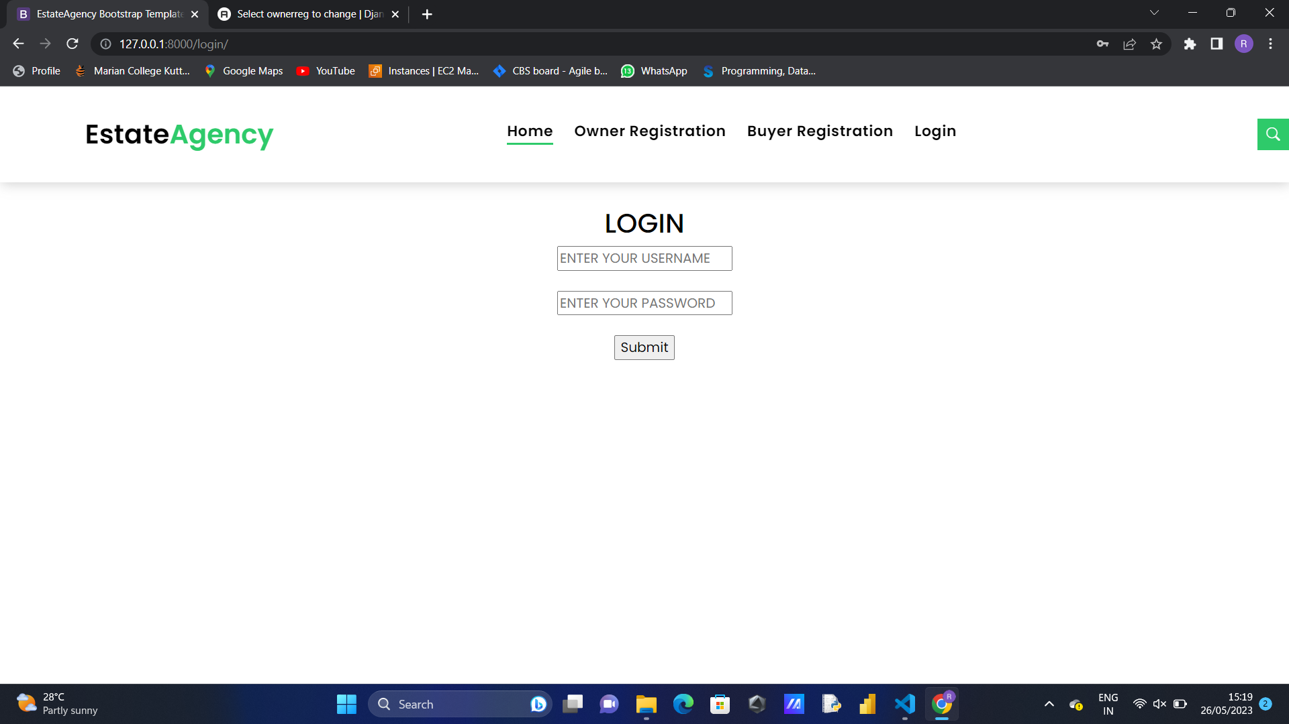
SCREENSHOTS
Login page for buyer and owner

Slide 9
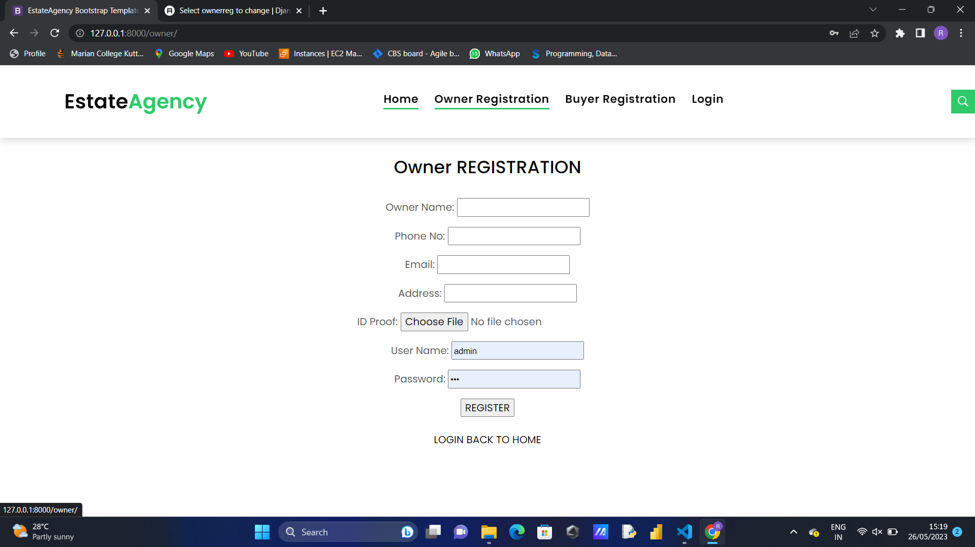
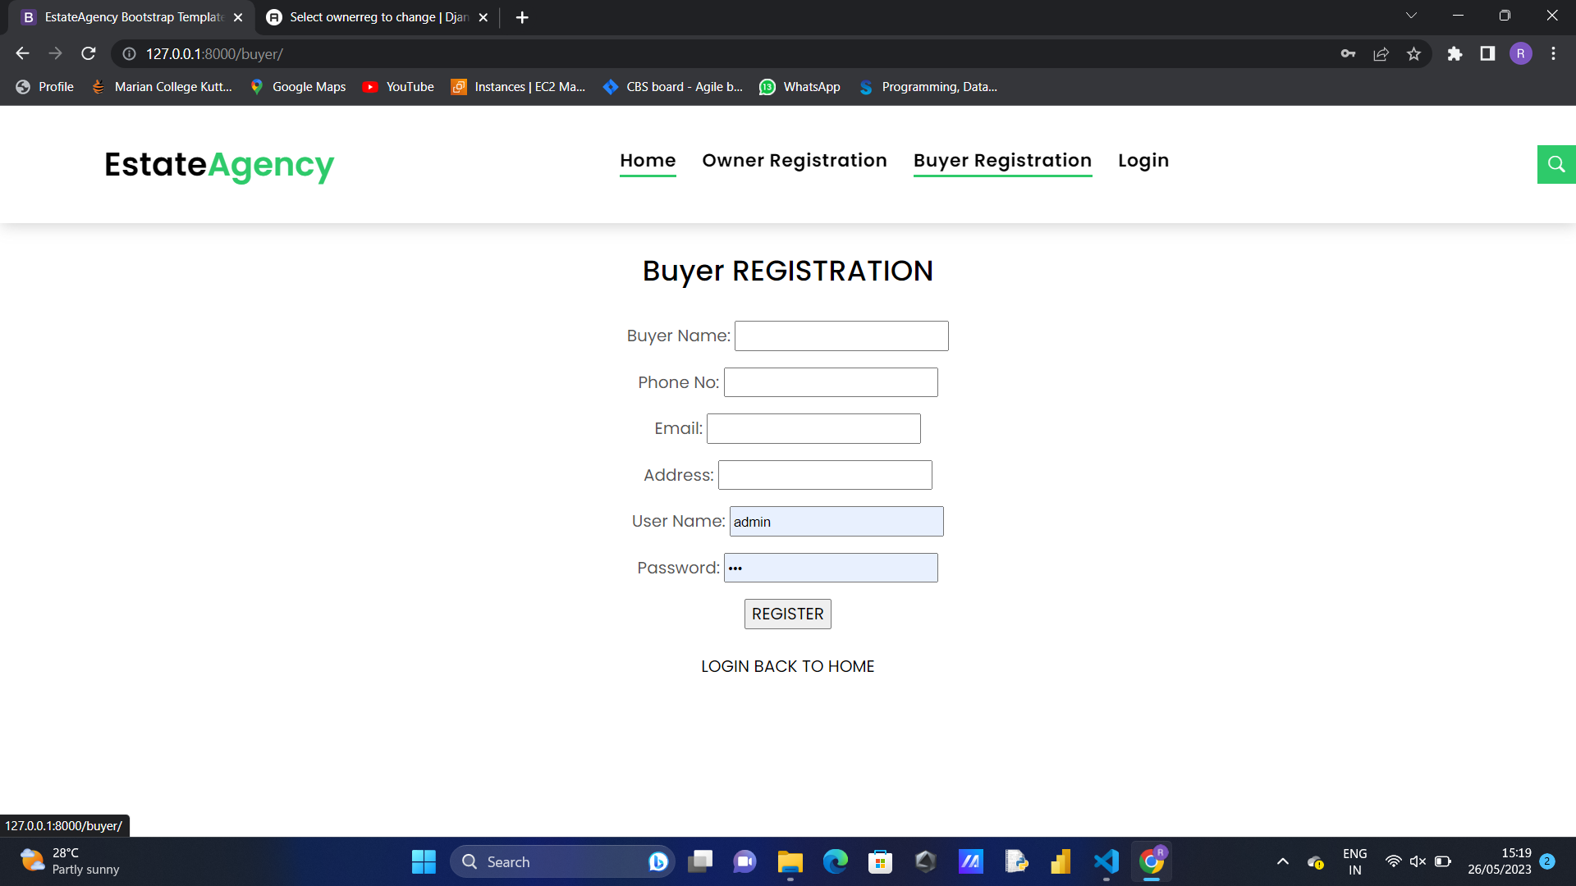
SCREENSHOTS
Buyer and owner registration page

Slide 10
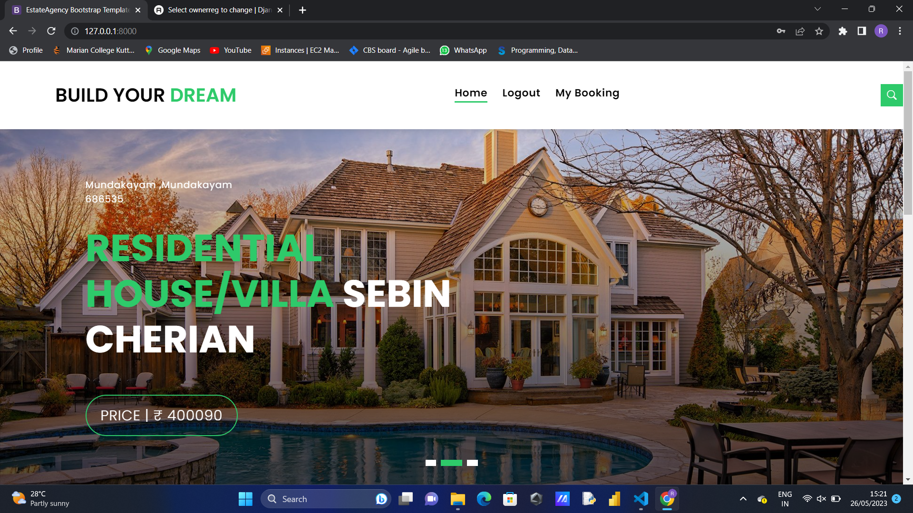
SCREENSHOTS
User home page

Slide 11
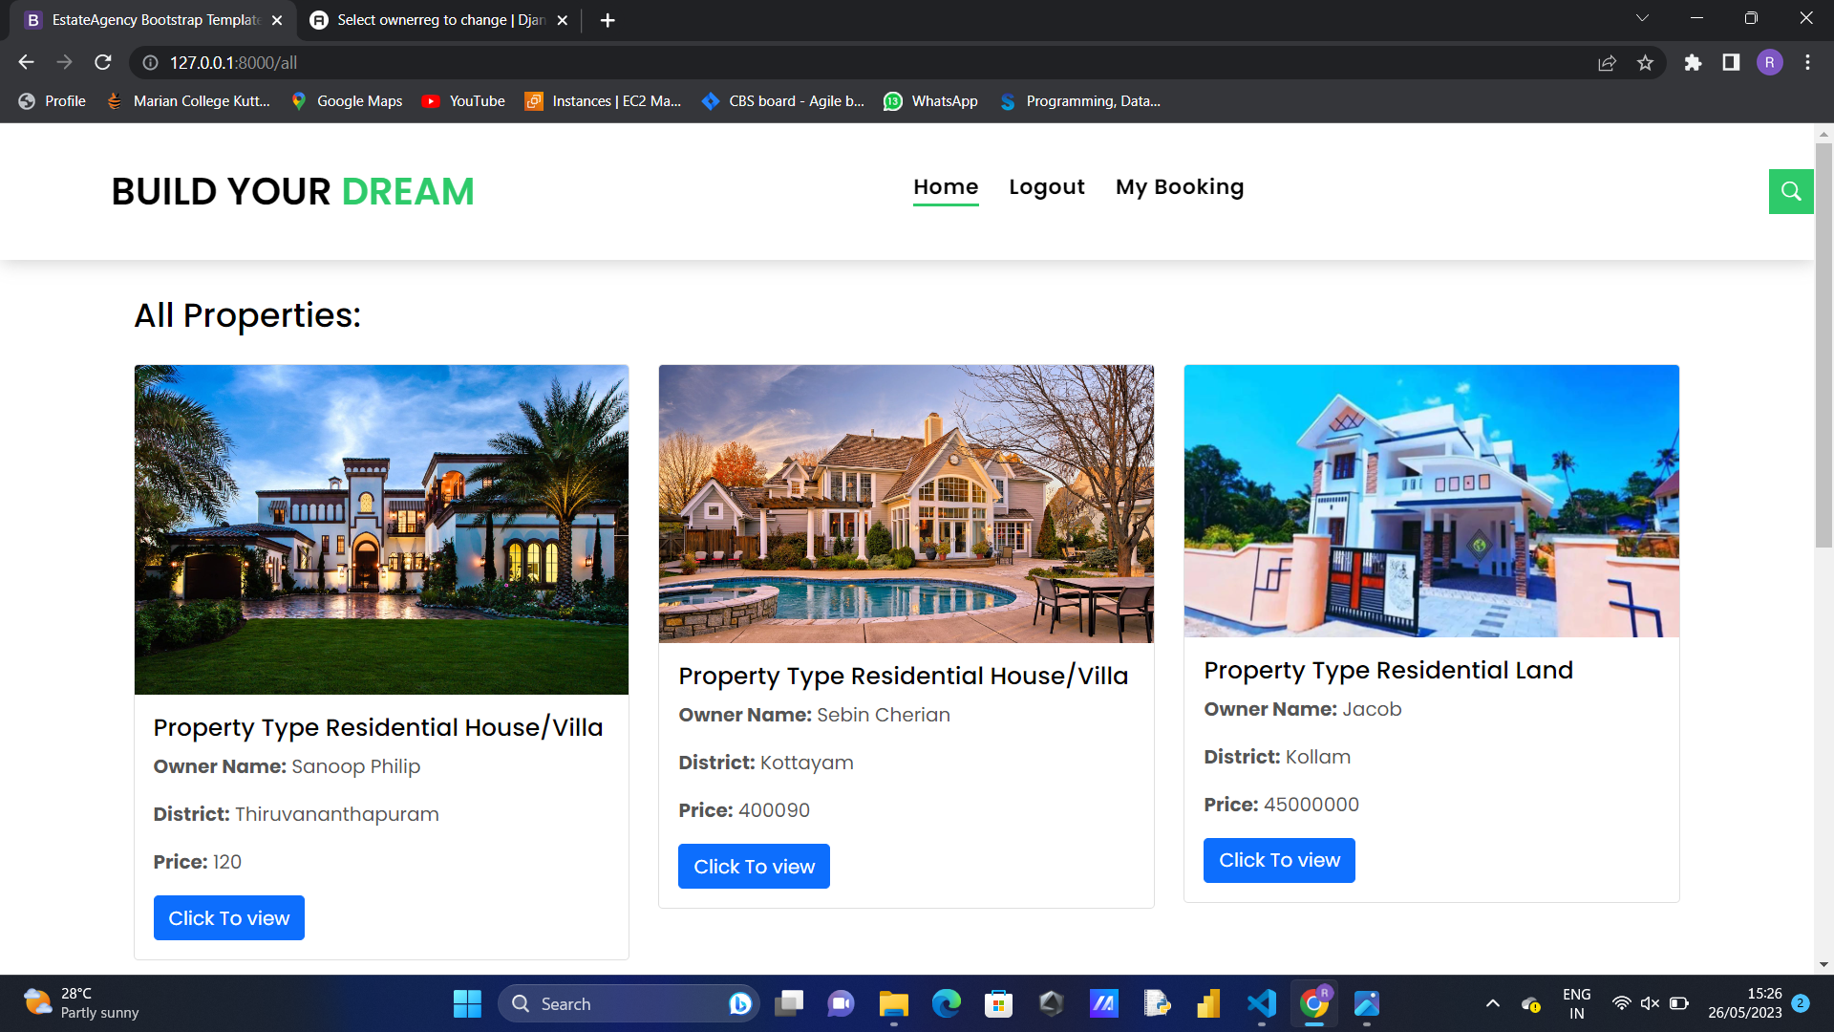
SCREENSHOTS
View all property page

Slide 12
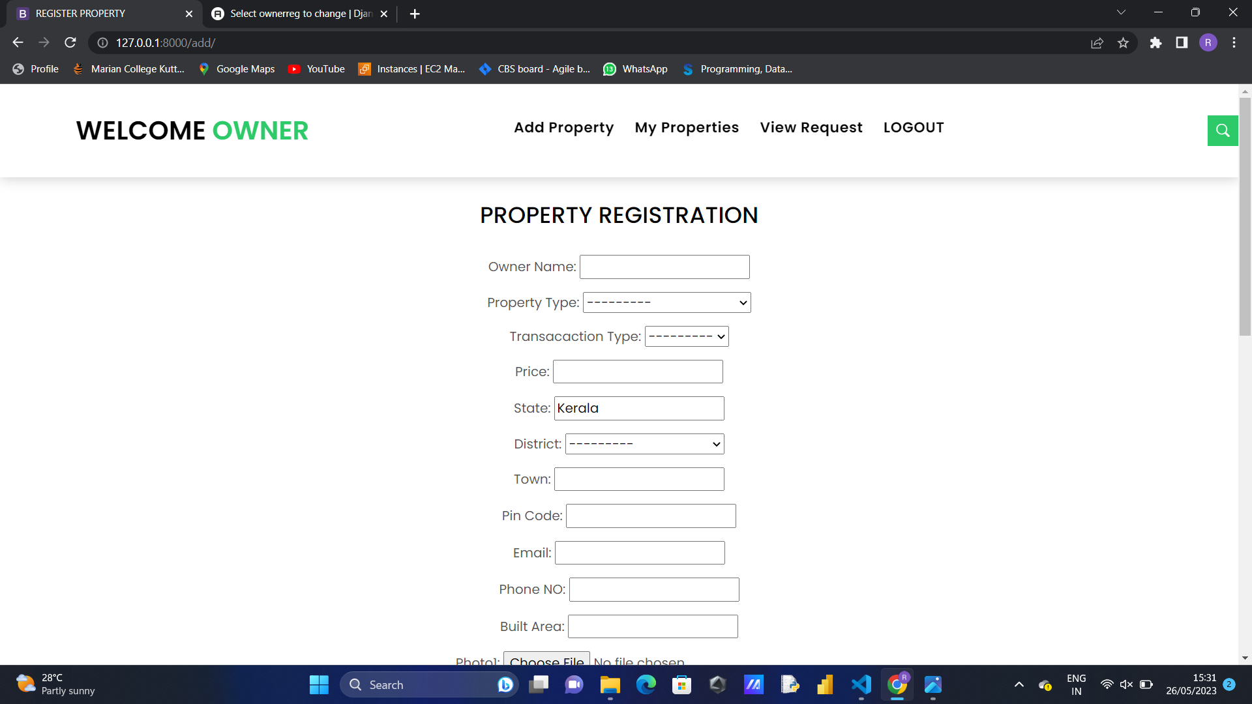
SCREENSHOTS
Add property page

Slide 13
CONCLUSION
The Online Real Estate Management System is a very helpful tool to fulfill in the field of real estate system provide major advantages such as speed and accuracy of operation, Time Efficiency, Cost Efficiency, Automatic data validation, Data security and reliability, Easy performance check ,Dynamic and User Friendly. Generates real-time, comprehensive reports and ensures access to complete and critical information, instantly. So it will be a good solution for the present problems of Property Management System. Many people search for property for many purposes like residence, offices, faculty and etc. Every individual wants his house to be in the best location with best facilities This online Property management system can help you to get best property by just sitting at home or anywhere.

Slide 14
Thank you
ROHAN CHERIAN
22PMC145

